Slide 1
Plotting

Slide 2
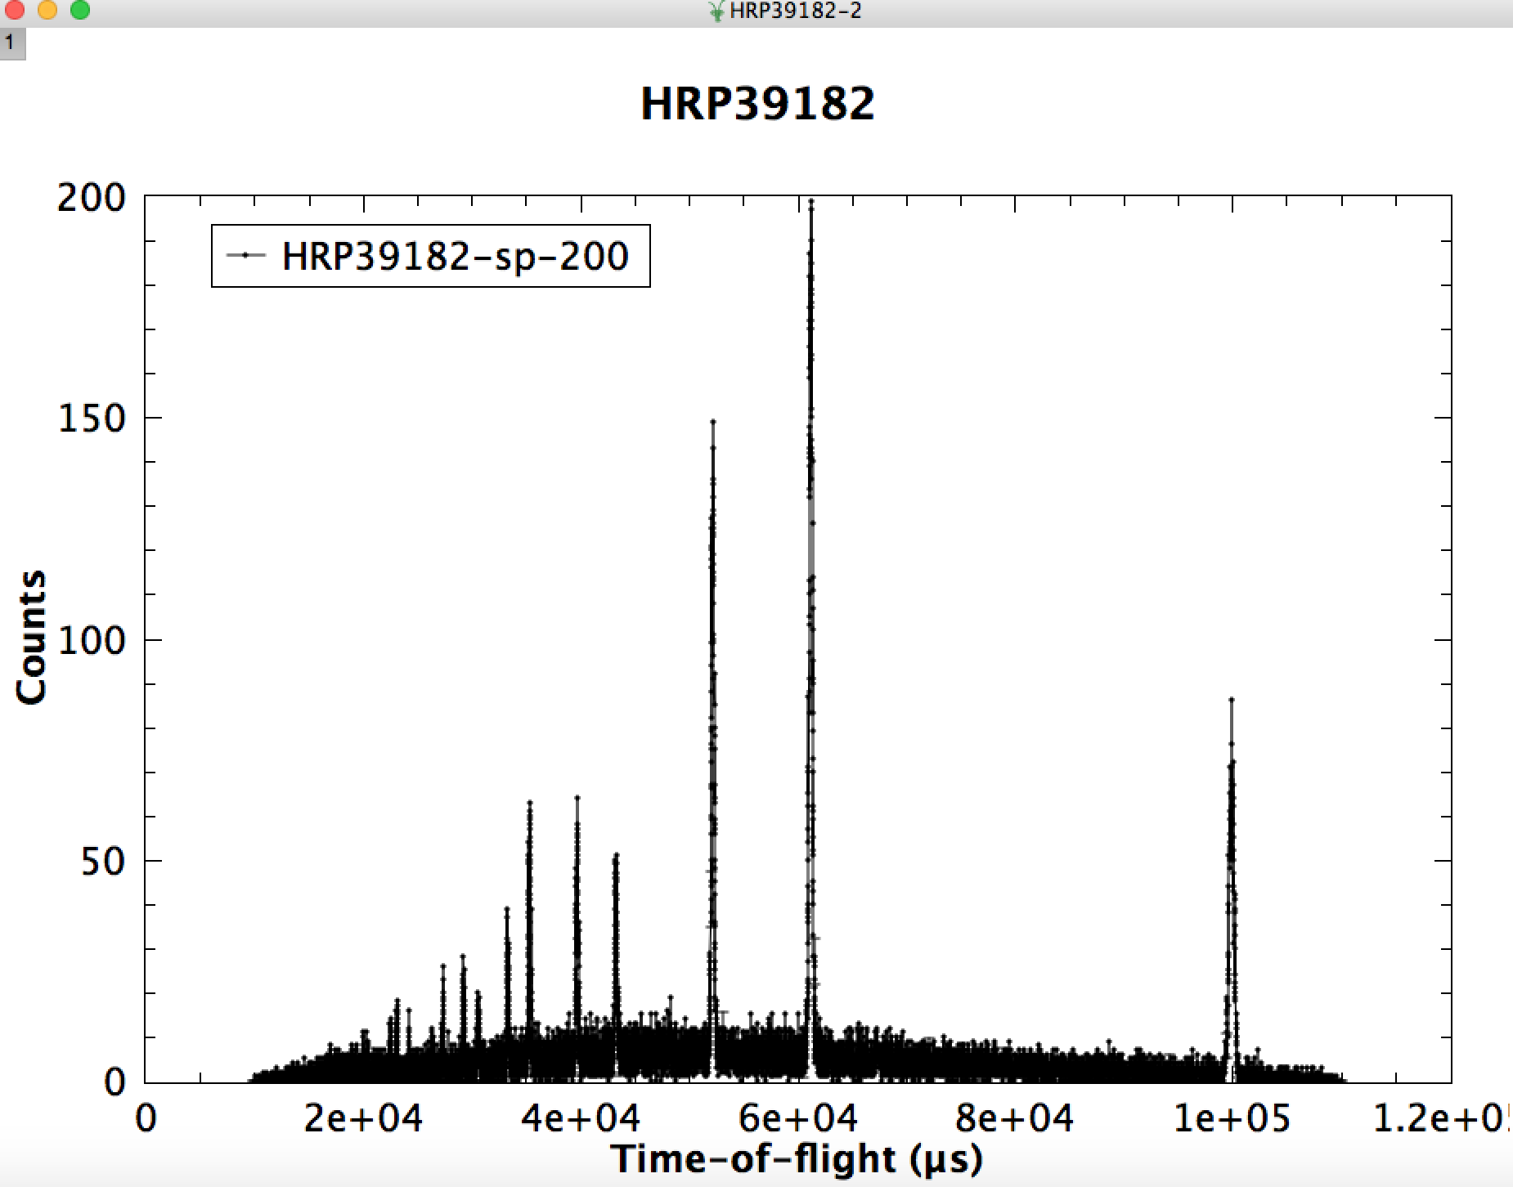
1D Plotting : Single or multi-curve

Slide 3
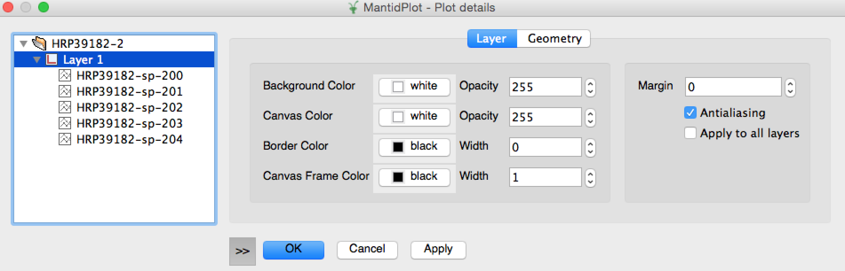
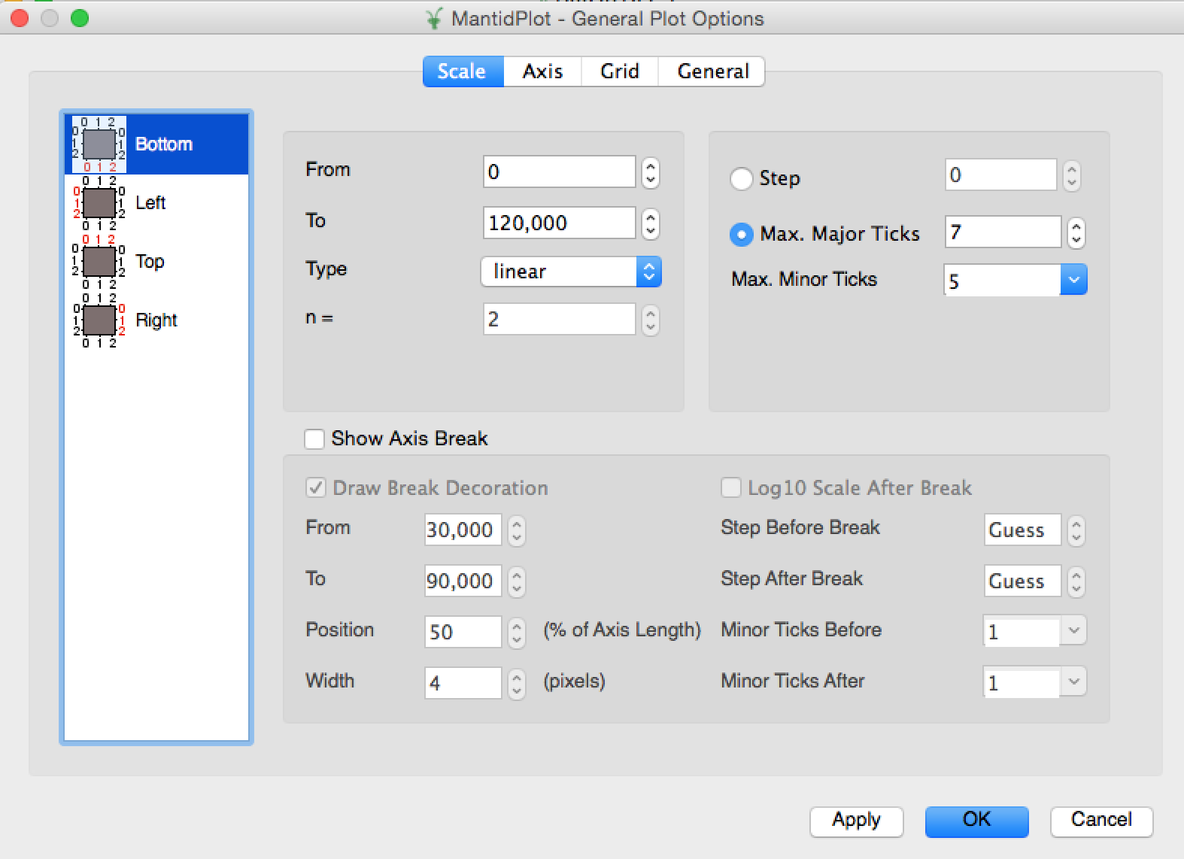
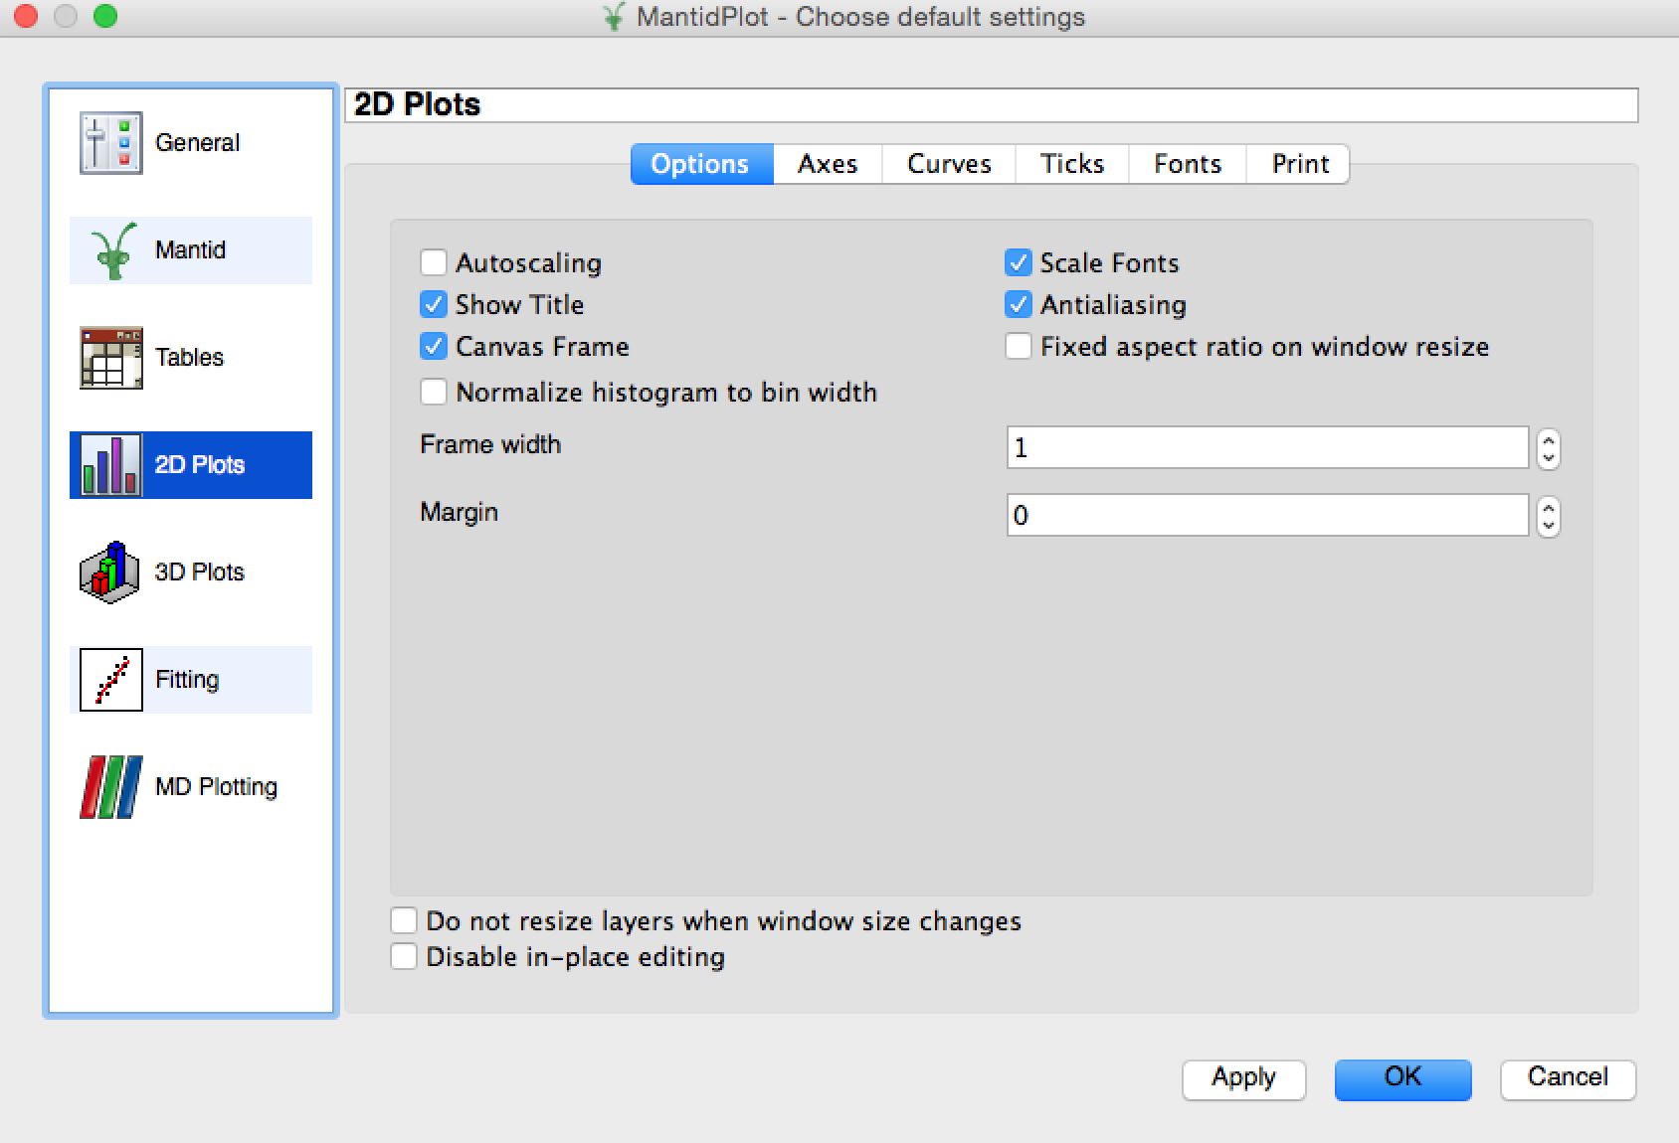
Graph Management

Slide 4
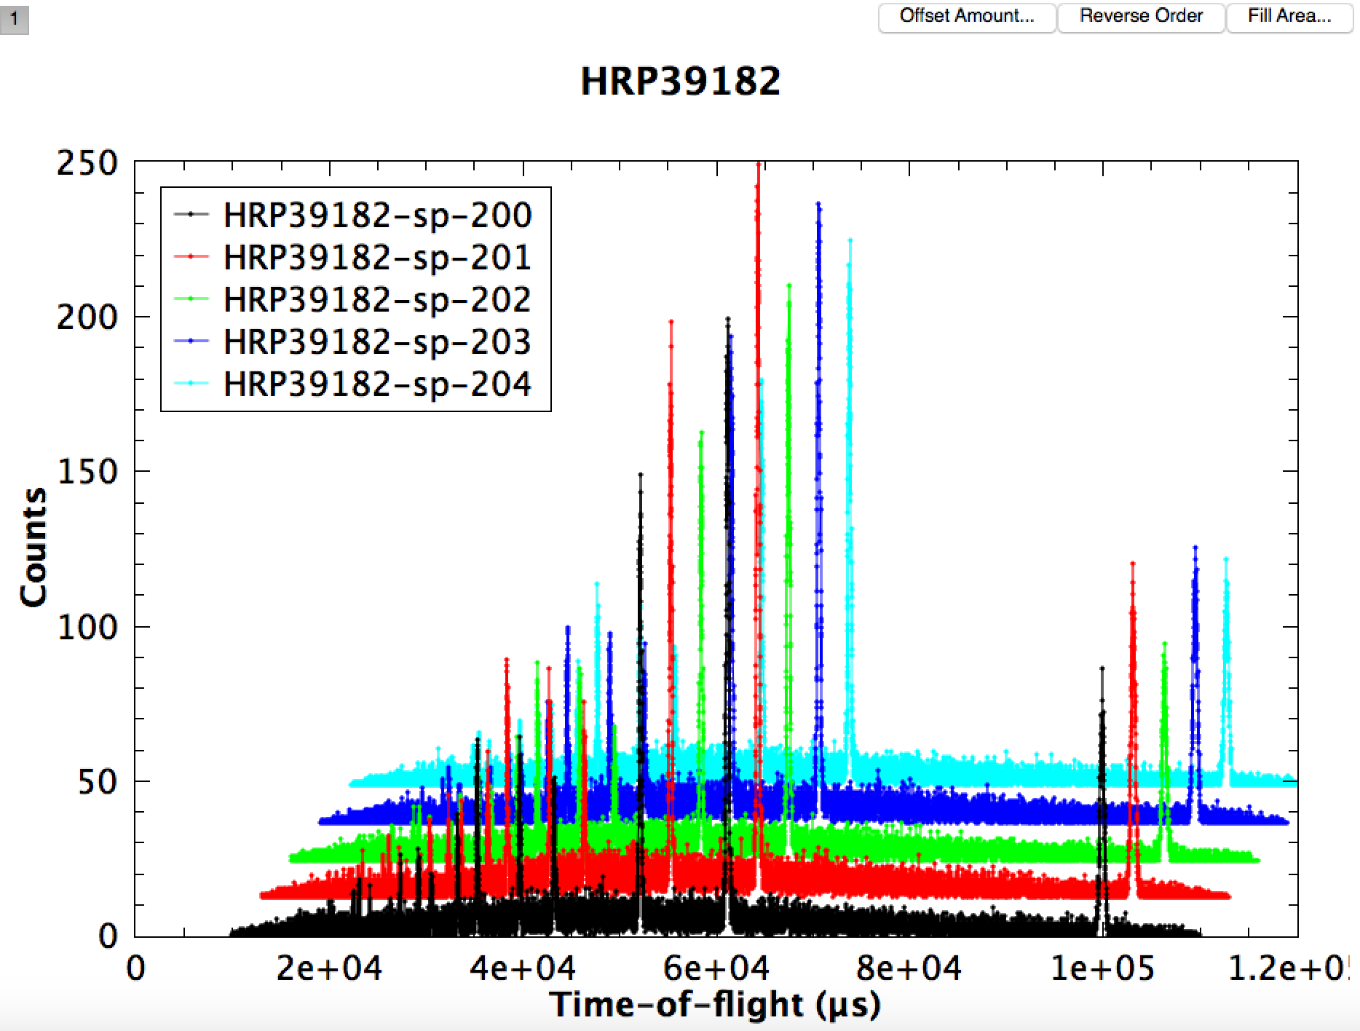
1D Plotting : Waterfall

Slide 5
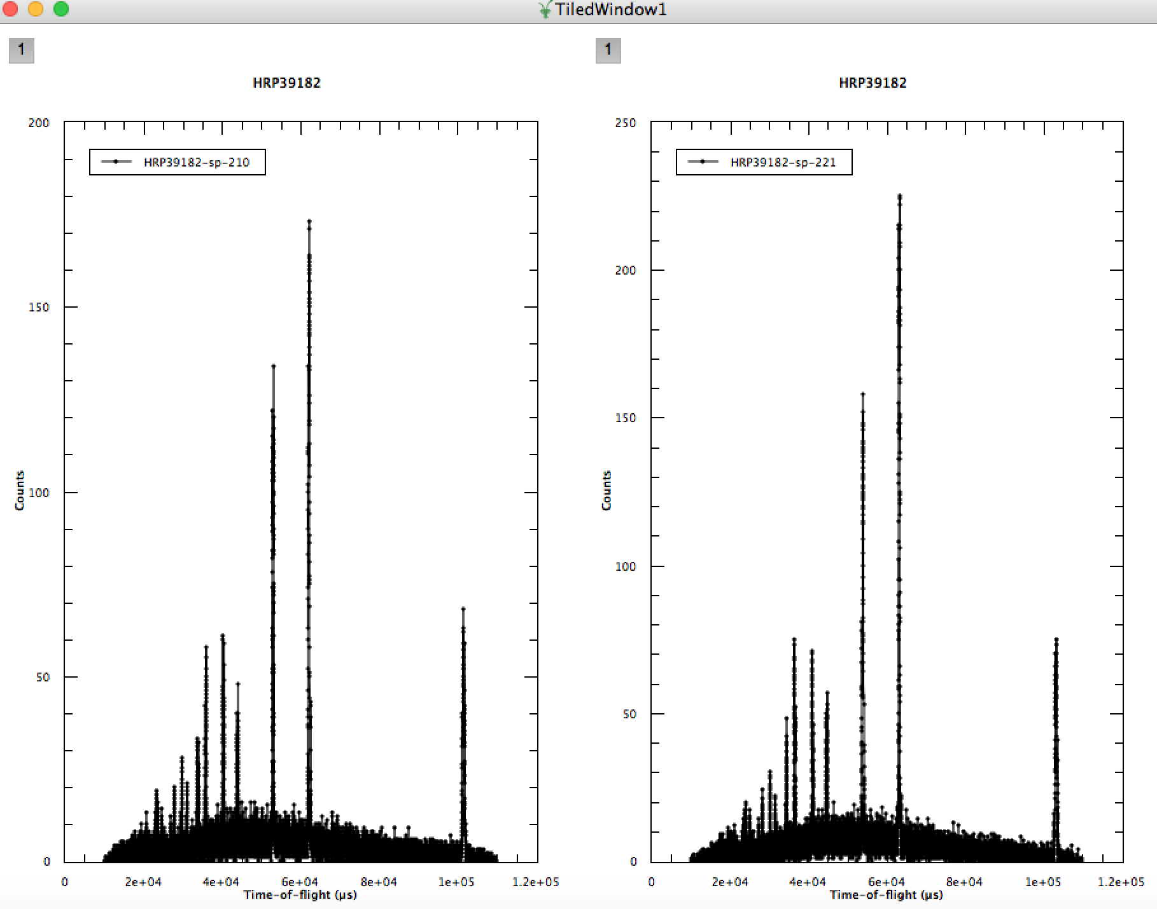
1D Plotting : Tiled

Slide 6
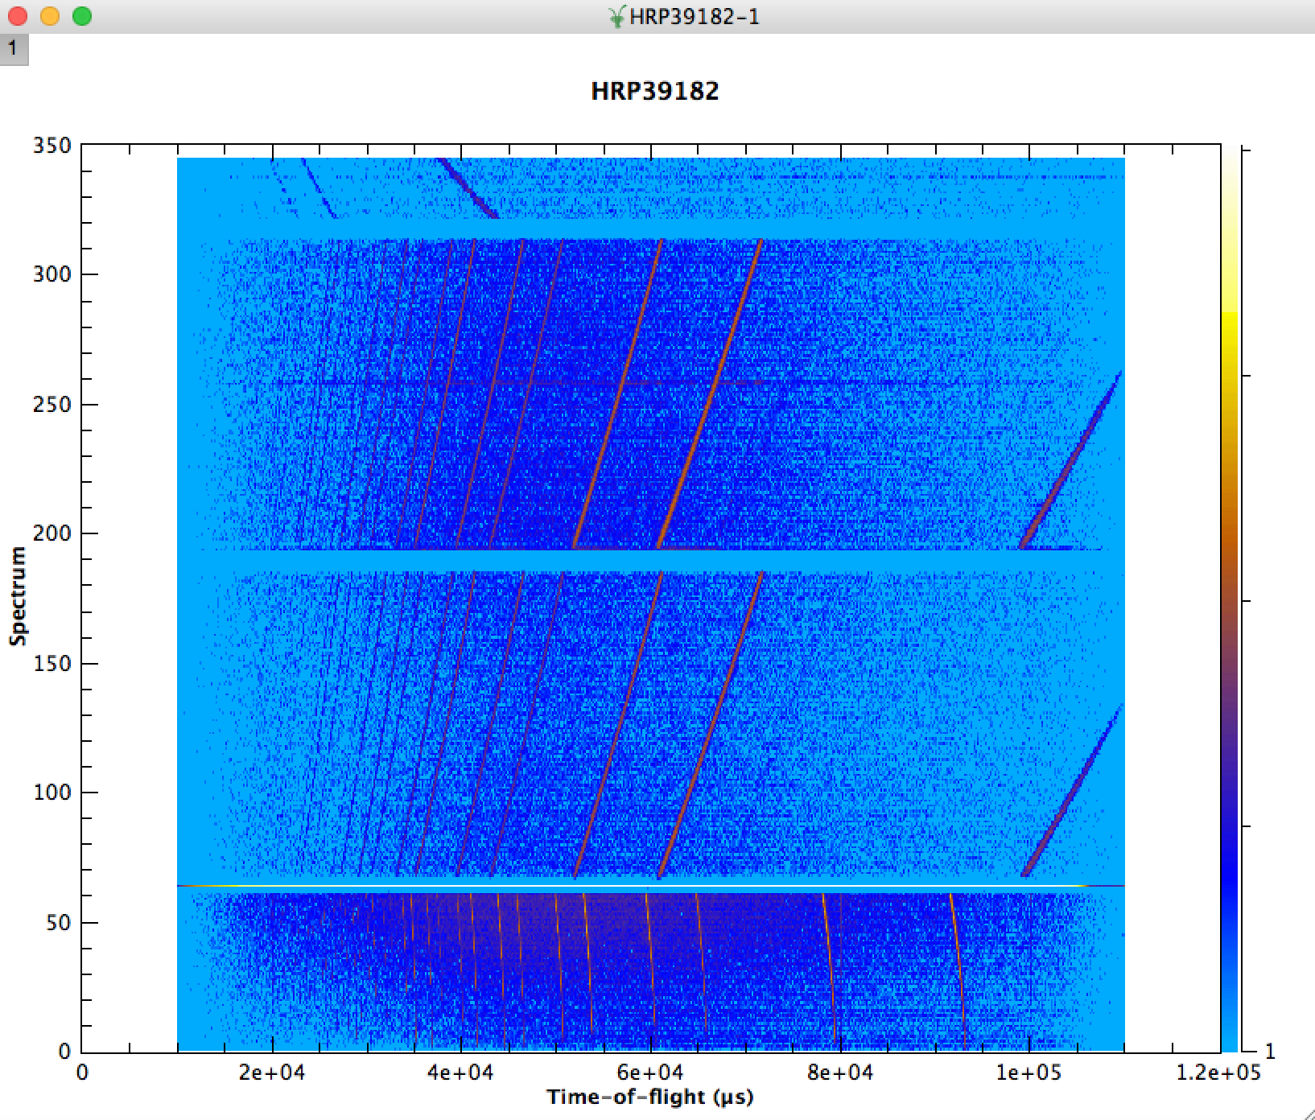
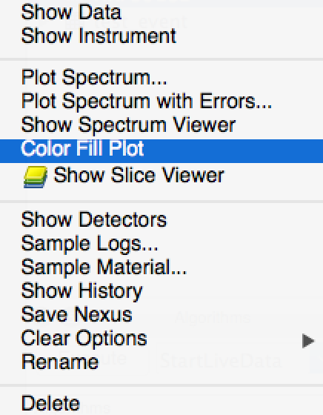
2D Plotting: Color Fill Plot

Slide 7
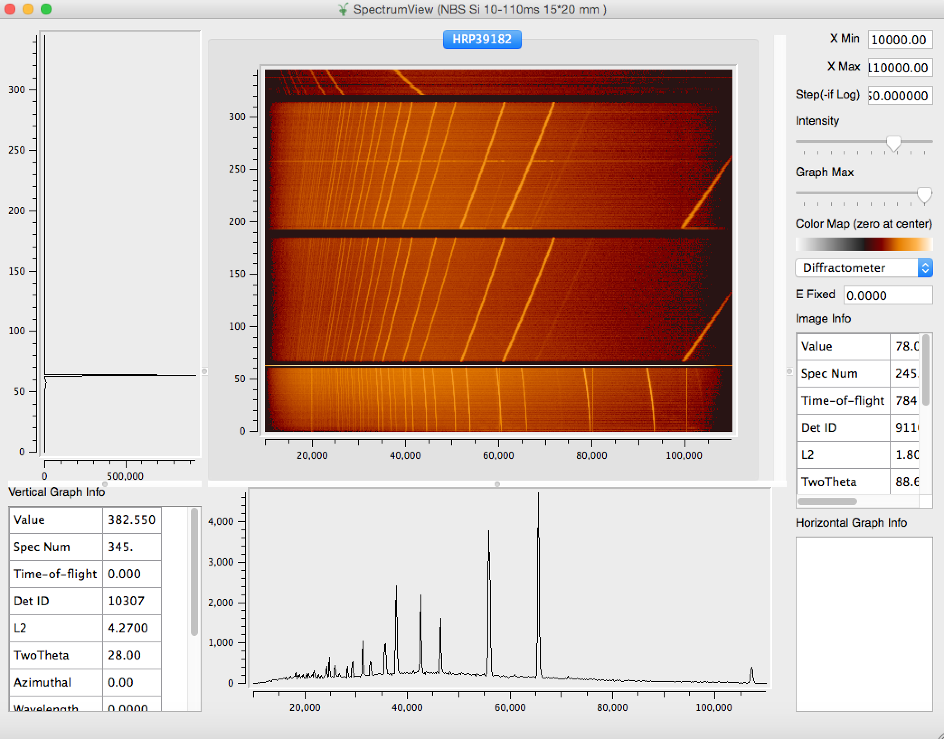
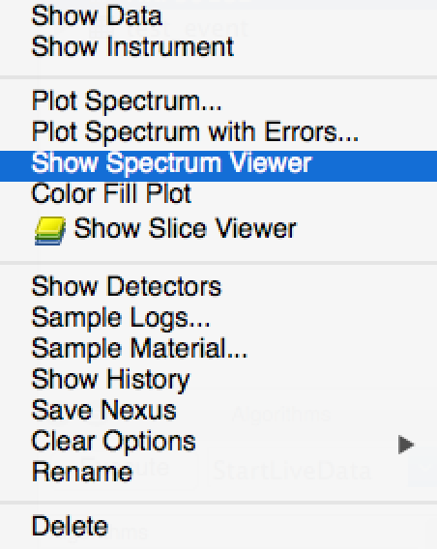
2D Plotting: Spectrum Viewer

Slide 8
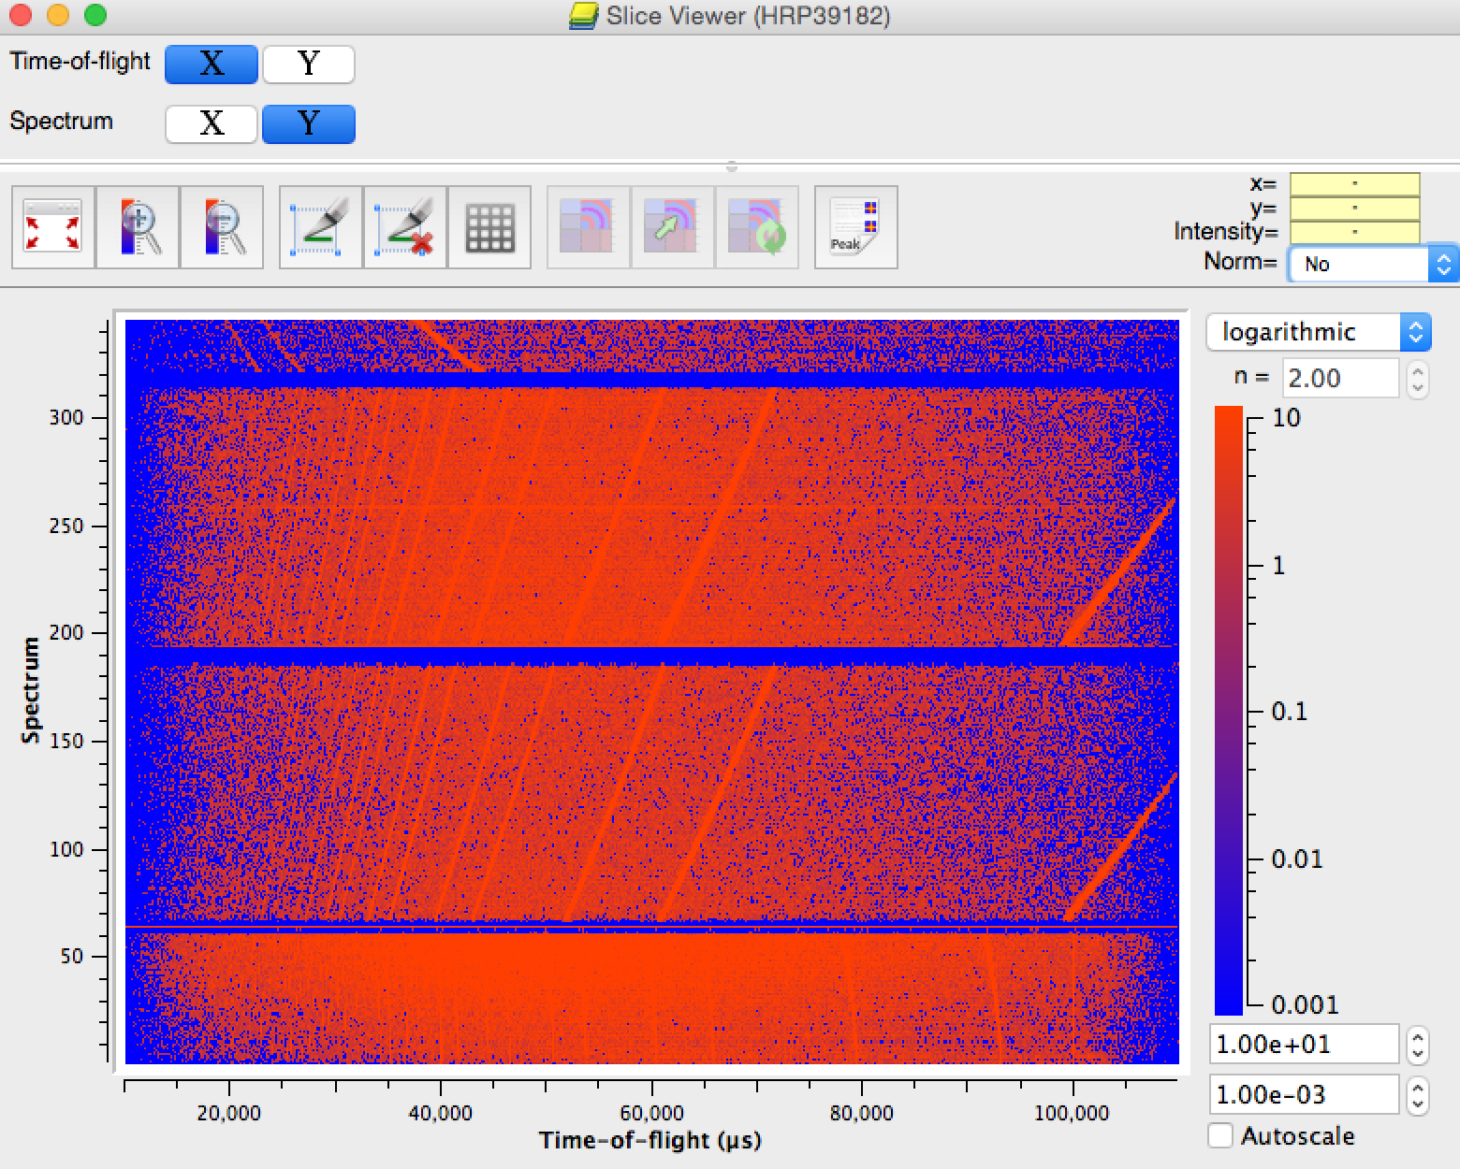
2D Plotting: Slice Viewer

Slide 9
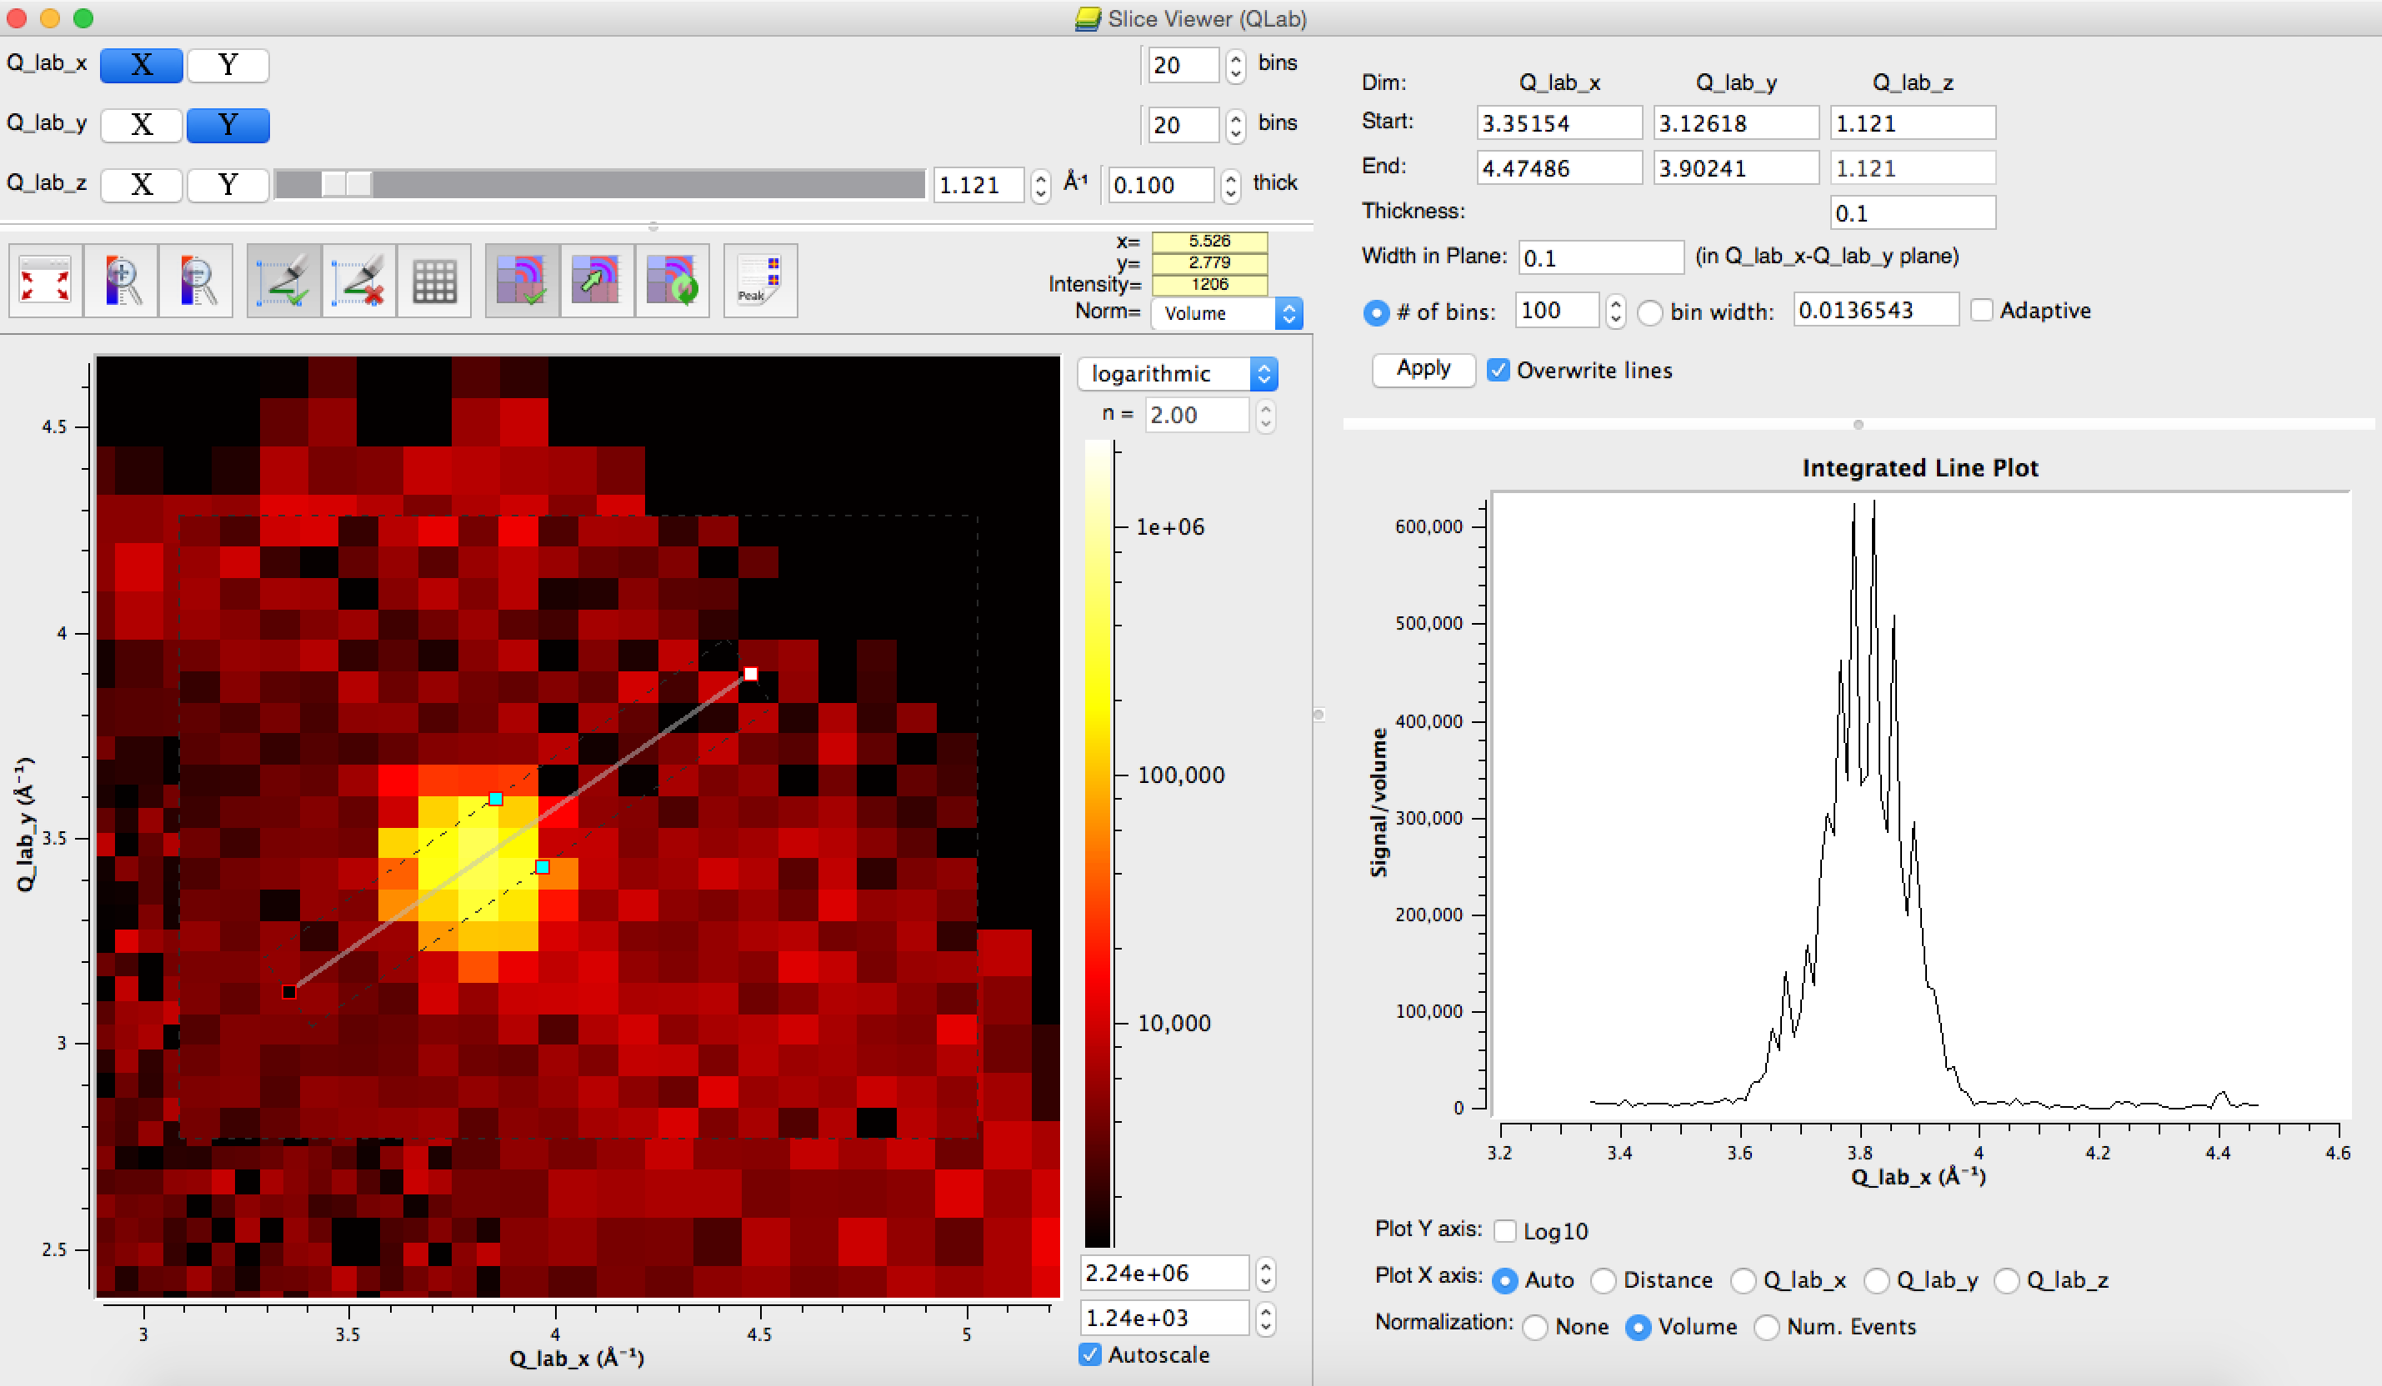
1D Plotting: Slice Viewer

Slide 10
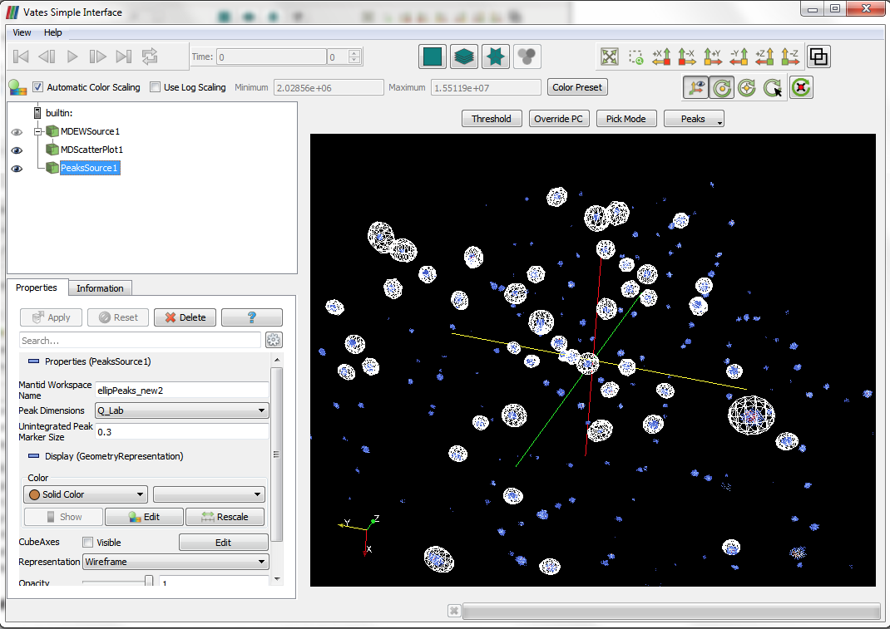
3D Plotting : 3D Viewer (a.k.a. VSI)

Slide 11
Documentation

Slide 12
Documentation
Basic Algorithm Documentation
Workflow Algorithm Documentation
Function Documentation
Technique Documentation
UI Documentation
Python Documentation
User content
Documentation Searchability

Slide 13
Fitting

Slide 14
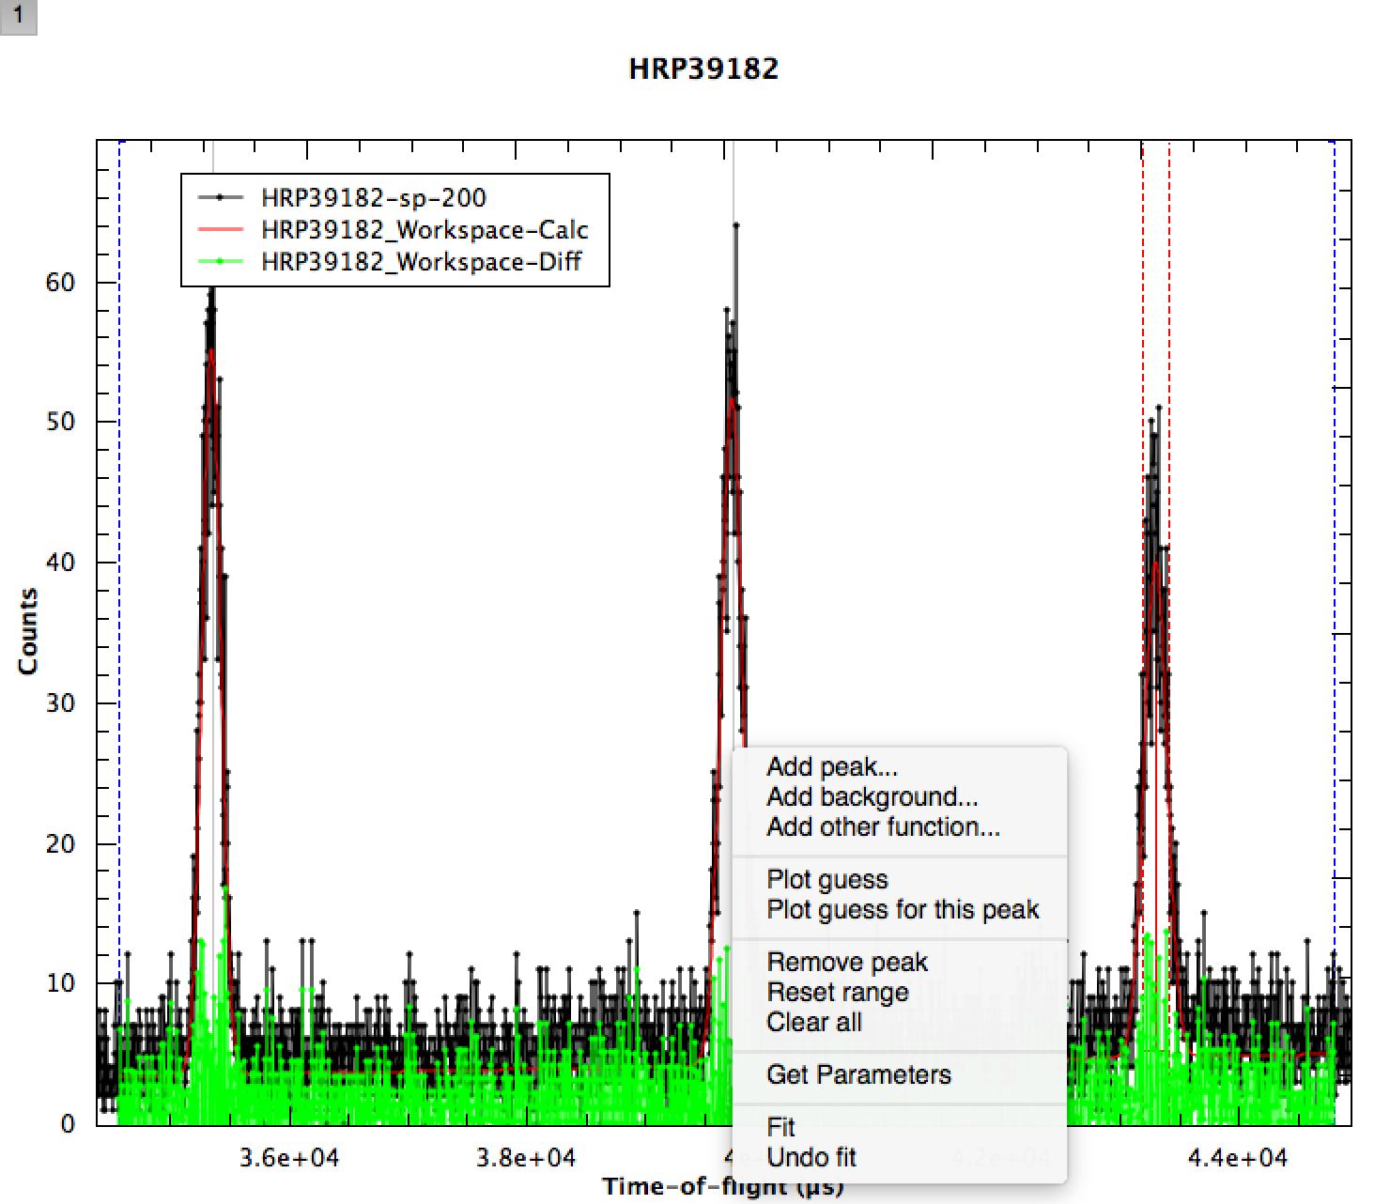
Basic Fitting

Slide 15
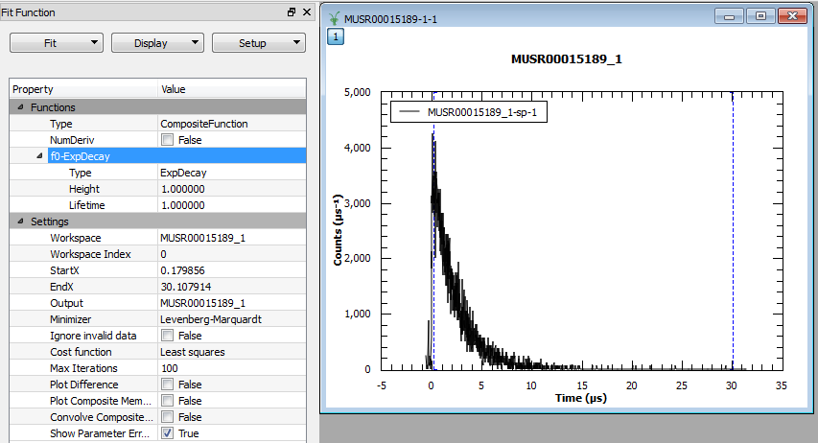
Sequential fitting
Plot a spectrum
Define common function

Slide 16
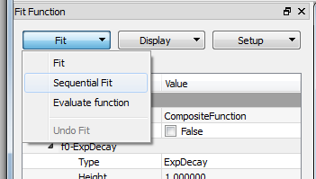
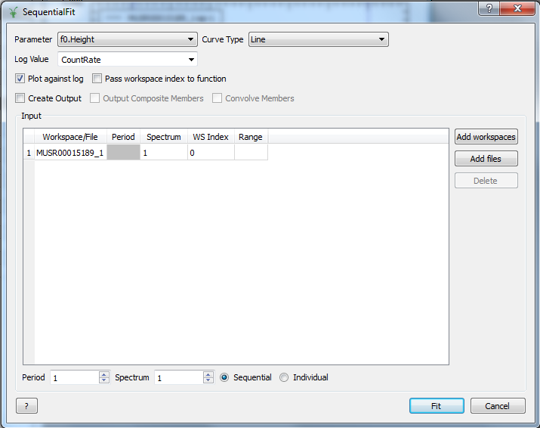
Sequential fitting
Open Sequential Fit dialog

Slide 17
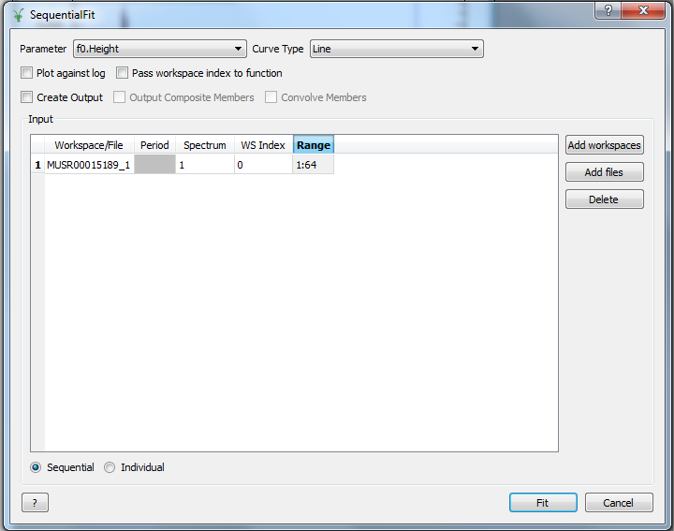
Sequential fitting
Select what to plot
Untick to plot against spectra
Range of spectra
(Ignored)
How to initialize parameters
Set fitting and plotting properties

Slide 18
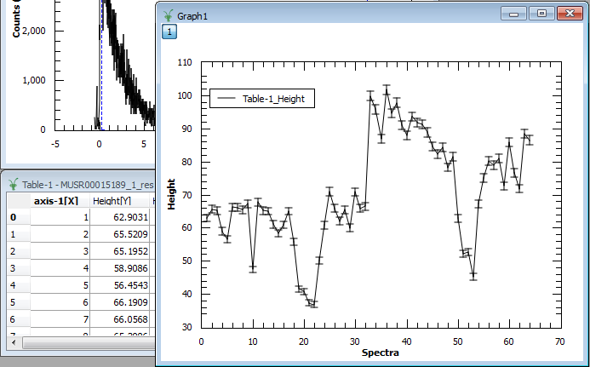
Sequential fitting
Fit and check the results

Slide 19
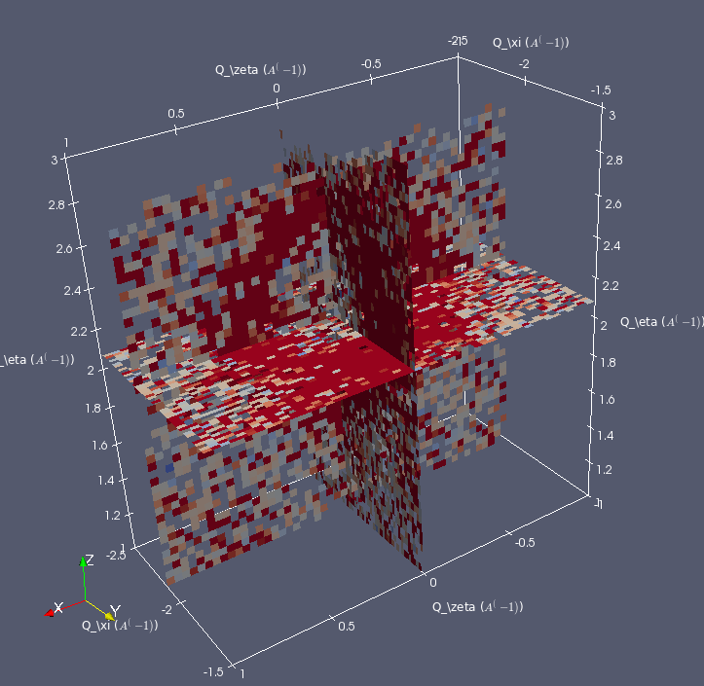
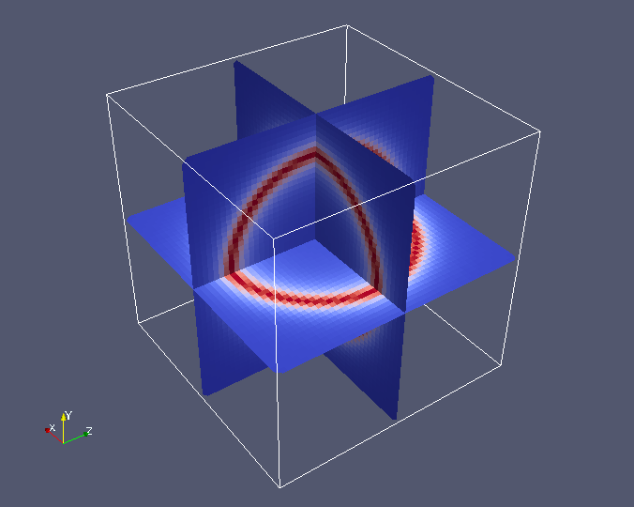
MD fitting
fun='name=UserFunctionMD,Formula=a*exp(-(sqrt((x)^2+(y+2.2)^2+(z-2.16)^2)-0.45)^2*(s)),a=40000,s=10'
ws = 'Slice3D'
Fit(fun,ws)

Slide 20
Scripting

Slide 21
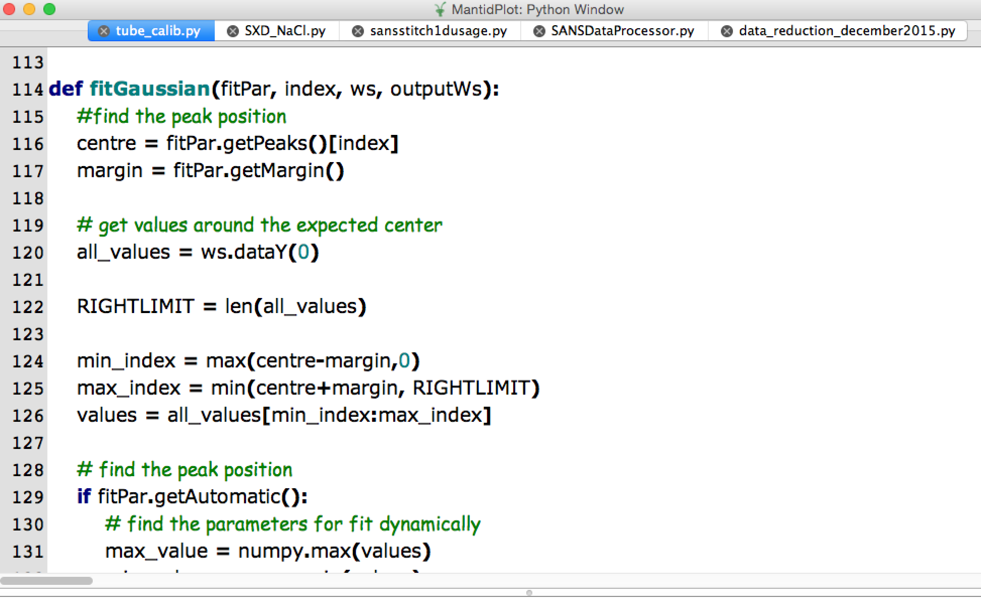
Script Window

Slide 22
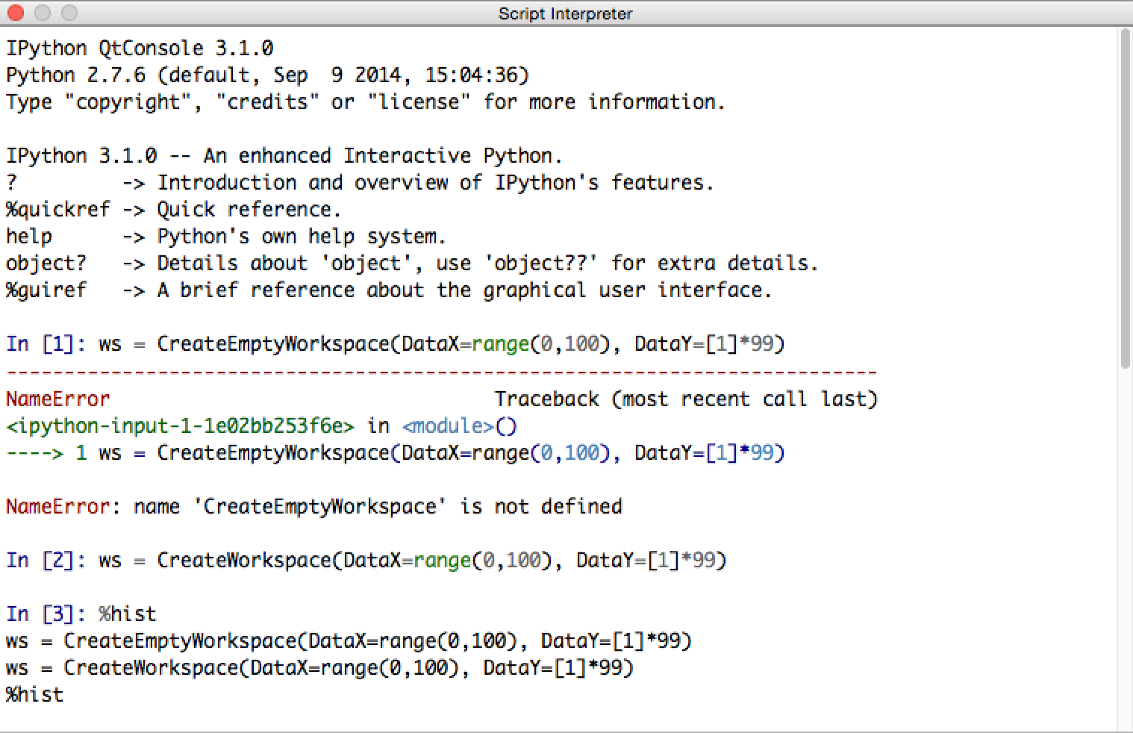
IPython Console

Slide 23
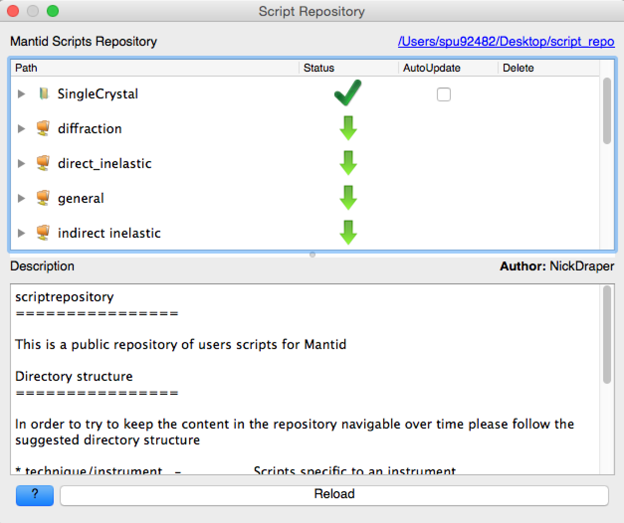
Script Repository

Slide 24
Python Plugins
ConjoinFiles.py
SortXAxis.py
Example1DFunction.py
Lorentz.py

Slide 25
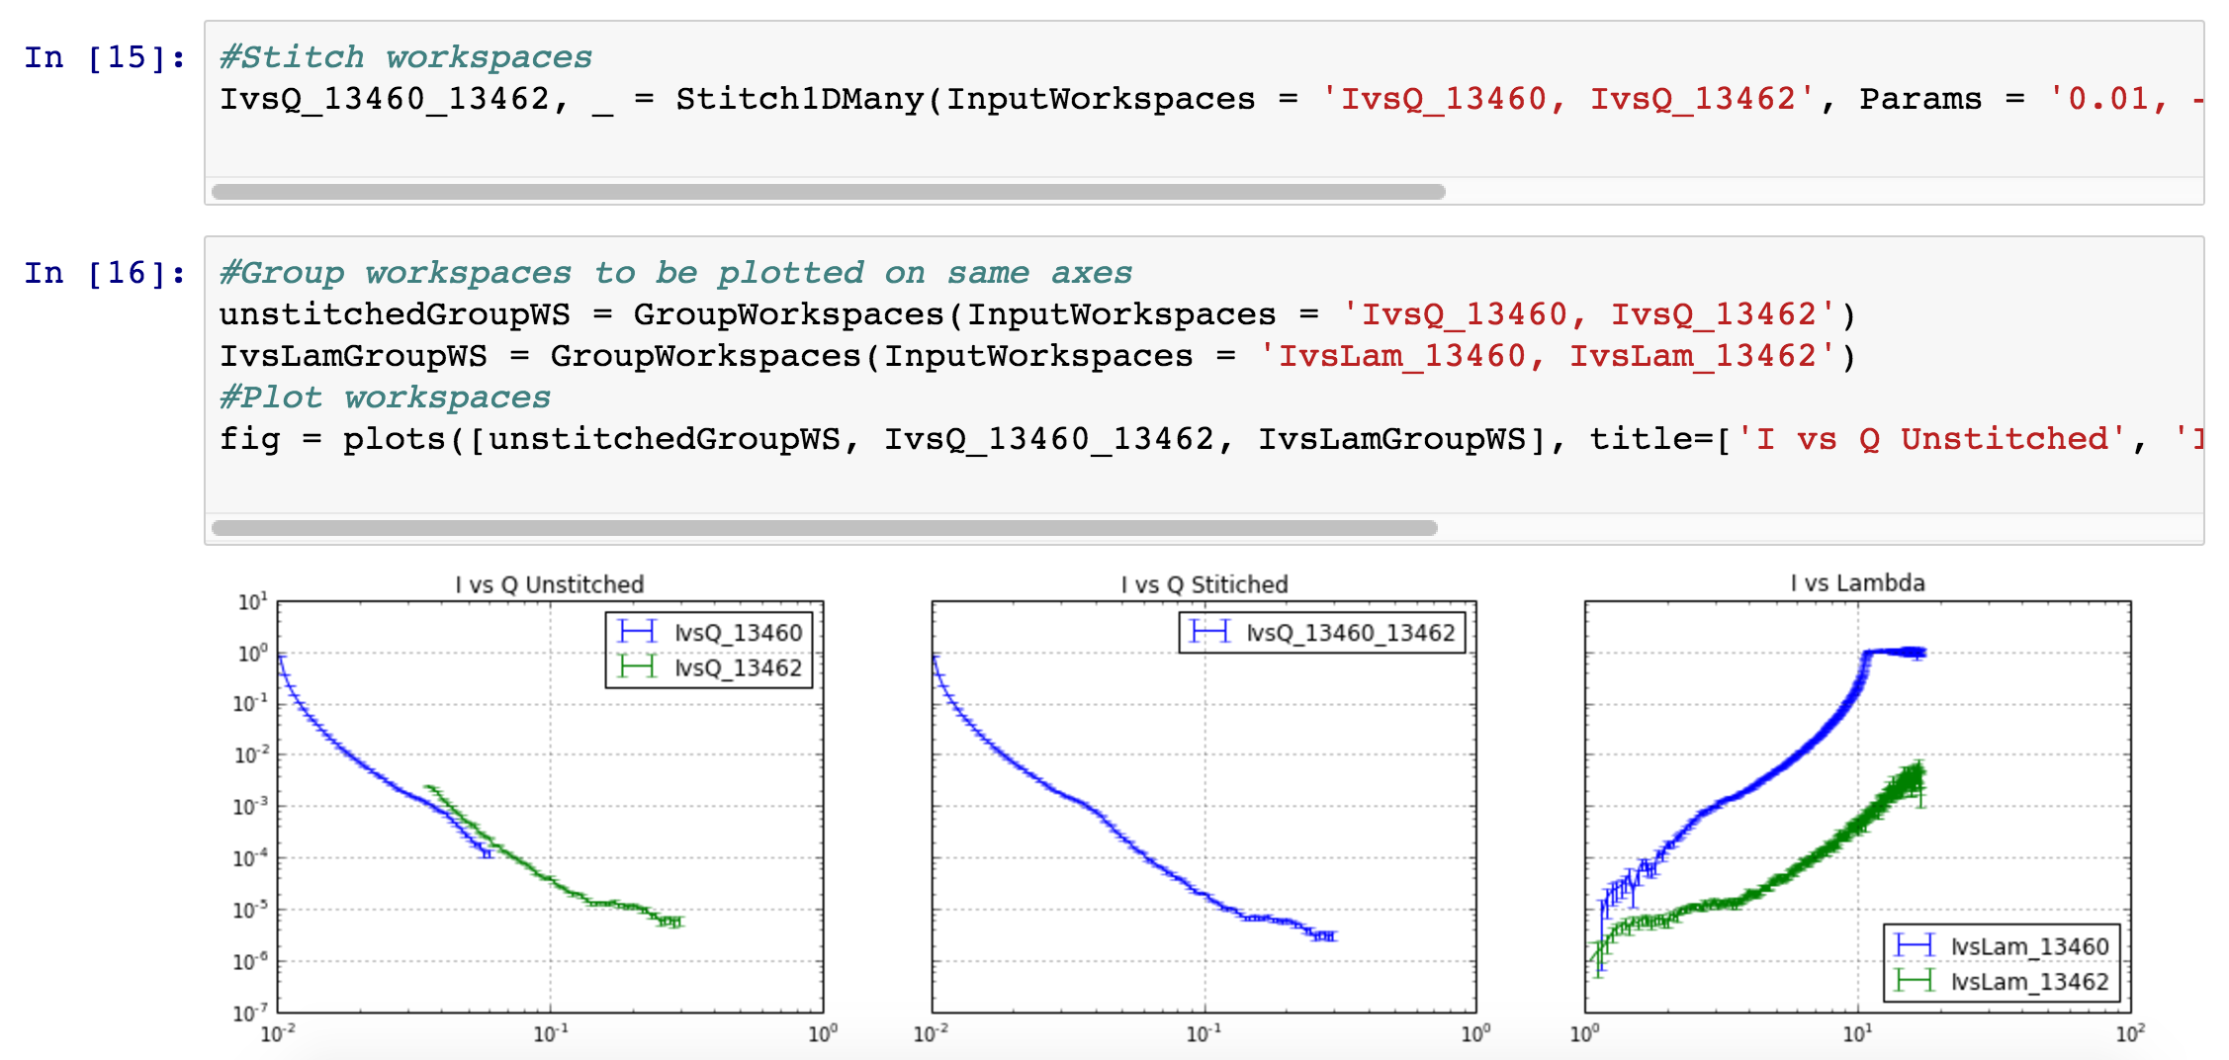
Electronic Notebooks

Slide 26
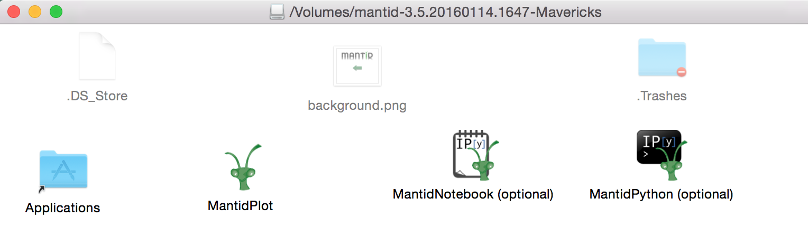
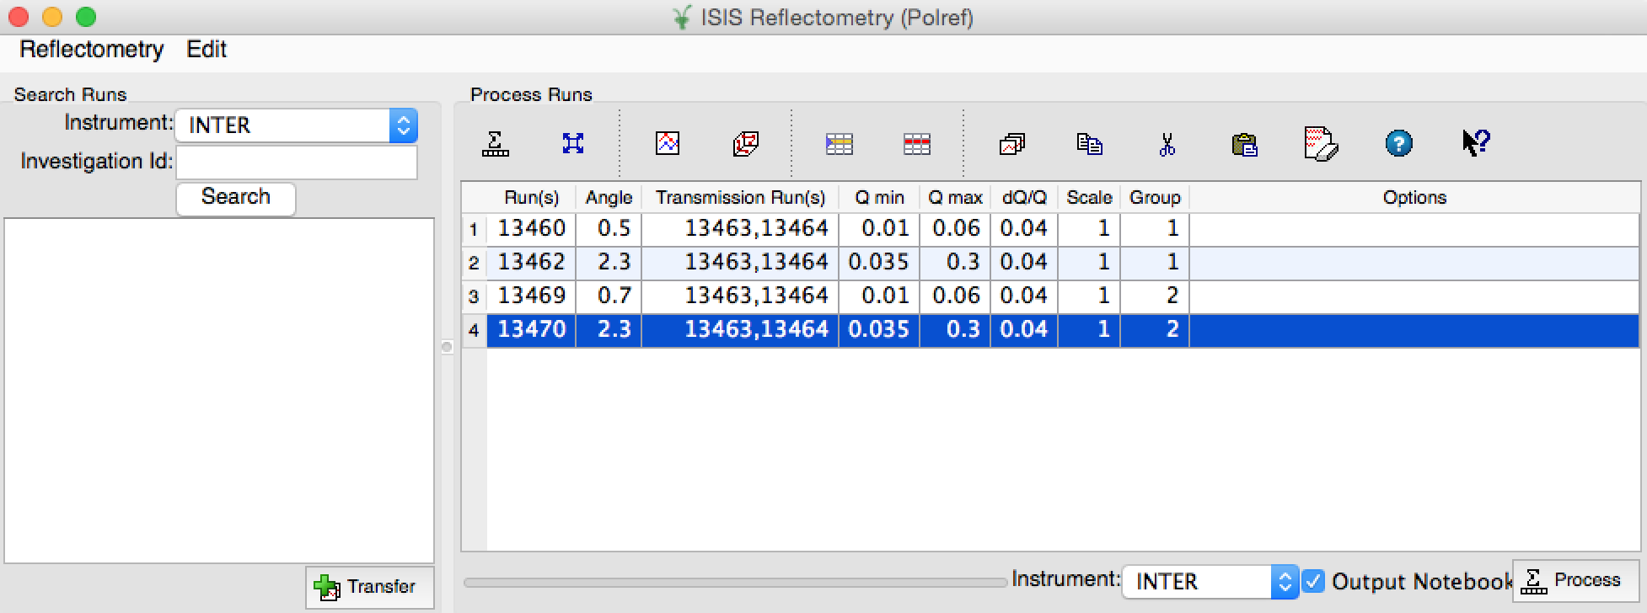
Electronic Notebooks

Slide 27
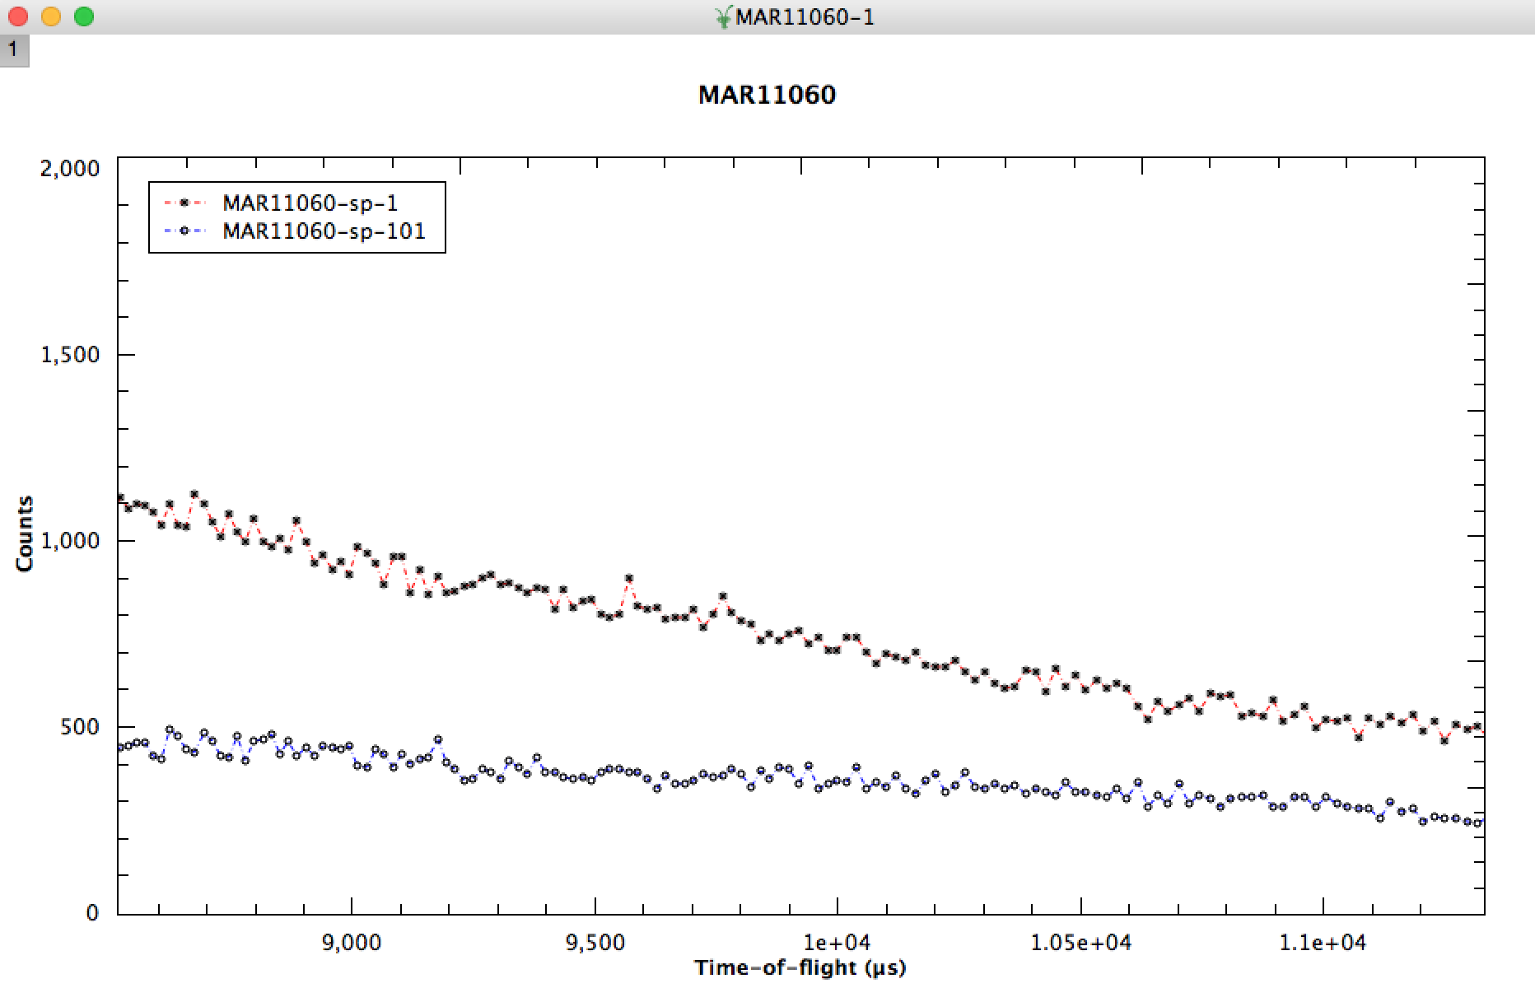
Mantid pyplot
pyplot

Slide 28
Other Topics

Slide 29
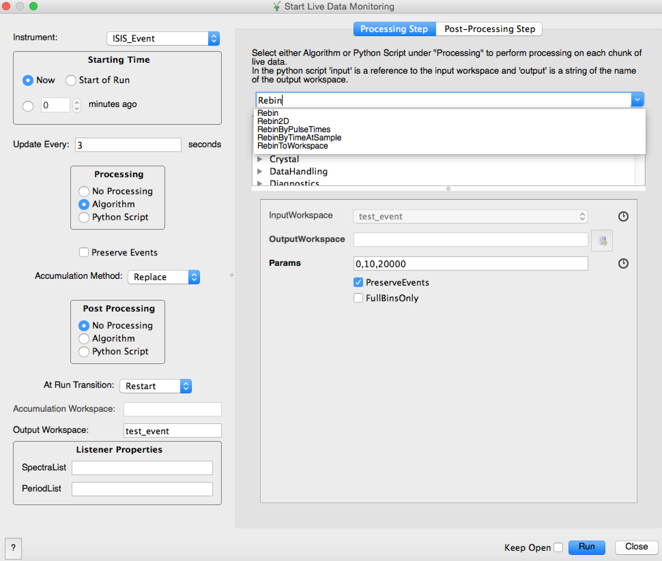
Live Data Processing

Slide 30
Training
Mantid Introduction Course
Introduction to Python
Python in Mantid
Extending Mantid with Python

Slide 31
Autoreduction

Slide 32
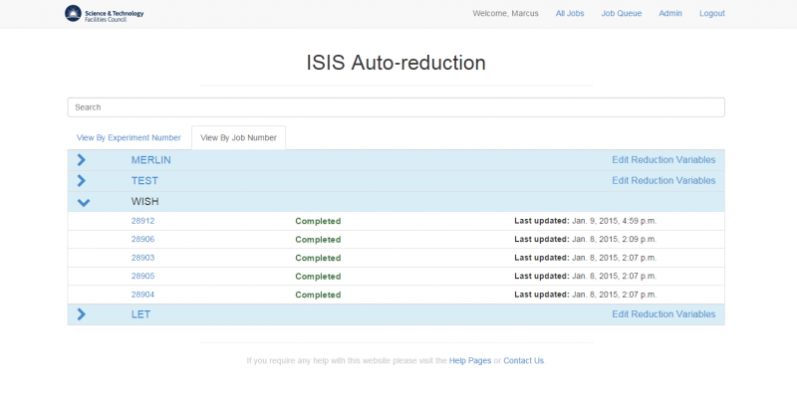
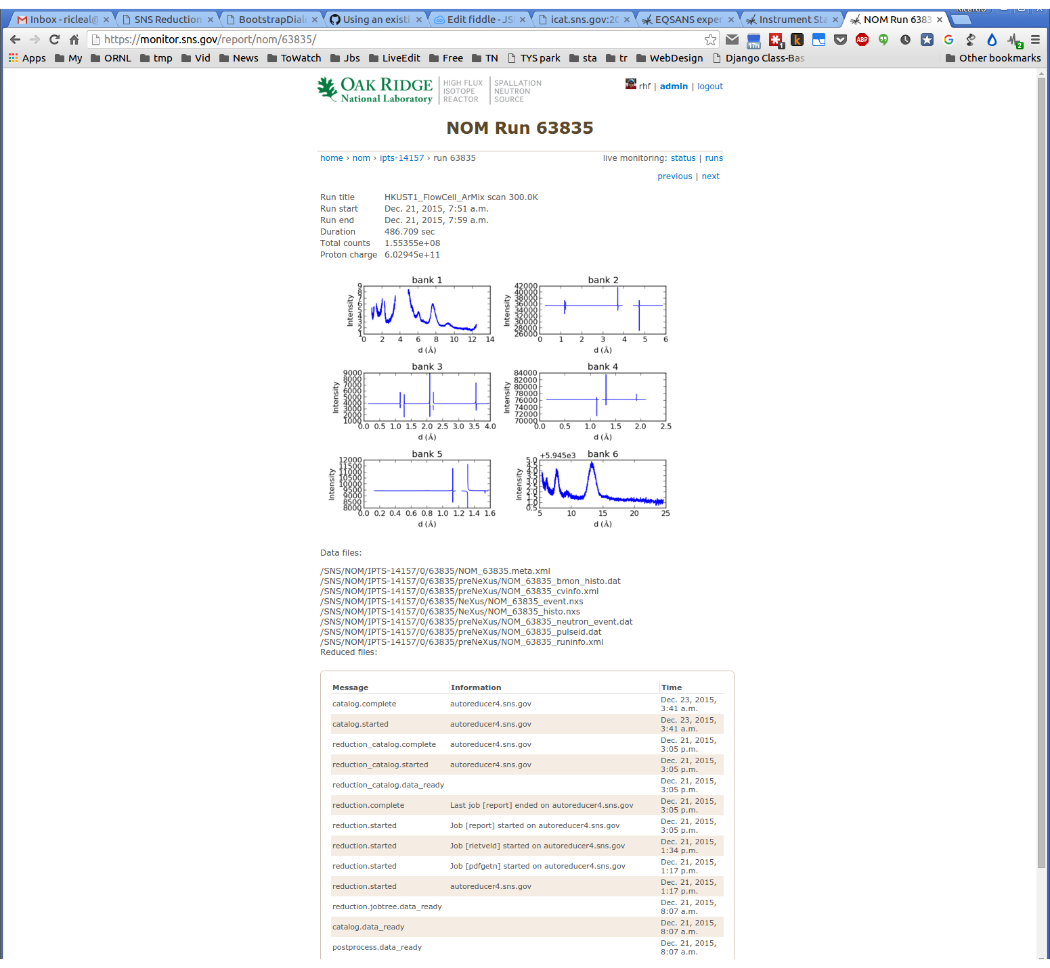

Slide 33
